Slide 1
Introduction to Computer Science
Computer Organization

Slide 2
Objectives
The components of a computer system
Putting all the pieces together—the Von Neumann architecture
Non-Von Neumann architectures

Slide 3
Introduction
Computer organization examines the computer as a collection of interacting “functional units”
Functional units may be built out of the circuits already studied
Higher level of abstraction assists in understanding by reducing complexity

Slide 4
Concept of Abstraction
Highest-level system view
S
Higher-level system view
A
B
C
a₁
a₃
a₆
Grouping components
a₅
a₁
a₂
a₄
a₇
Detailed system view

Slide 5
Components of a Computer System
Von Neumann architecture has four functional units
Memory
Input/Output
Arithmetic/Logic unit
Control unit
Sequential execution of instructions
Stored program concept

Slide 6
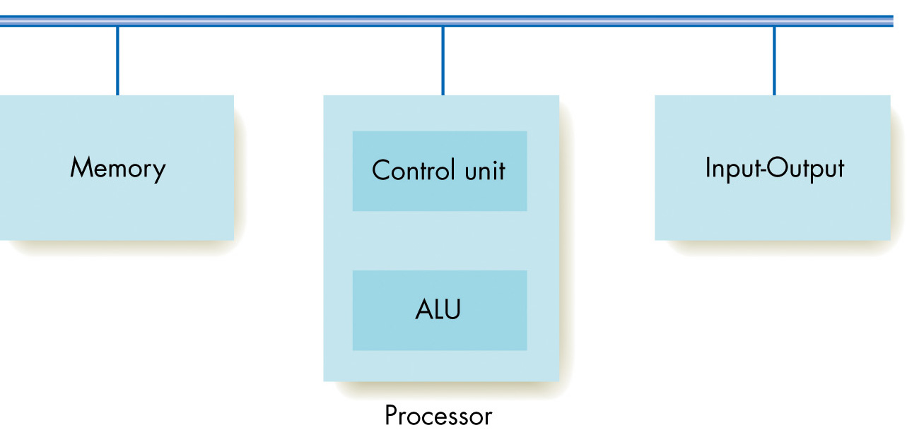
Components of a Computer System
Von Neumann architecture has four functional units
Bus

Slide 7
Components of a Computer System
Logical organization of computer
Memory
Input
CPU
Output
ALU
Secondary
Storage

Slide 8
Memory and Cache
Information stored and fetched from memory subsystem
Random access memory maps addresses to memory locations
Cache memory keeps values currently in use in faster memory to speed access times

Slide 9
Memory and Cache (continued)
RAM (random access memory)
Memory made of addressable cells
Current standard cell size is 8 bits
All memory cells accessed in equal time
Memory address
Unsigned binary number N long
Address space is then 2^{N} cells

Slide 10
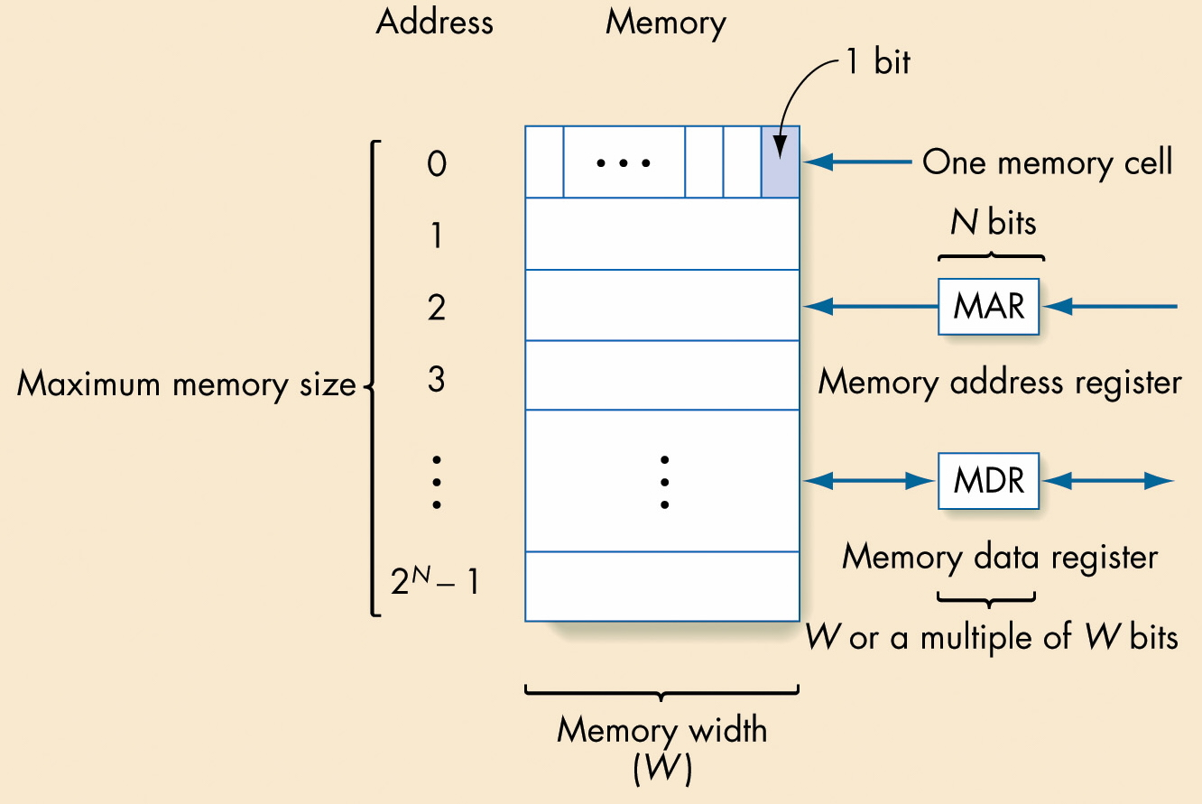
Structure of Random Access Memory

Slide 11
Memory and Cache (continued)
Parts of the memory subsystem
Fetch/store controller
Fetch: Retrieve a value from memory
Store: Store a value into memory
Memory address register (MAR)
Memory data register (MDR)
Memory cells with decoder(s) to select individual cells

Slide 12
Memory and Cache (continued)
Fetch operation
The address of the desired memory cell is moved into the MAR
Fetch/store controller signals a fetch, accessing the memory cell
The value at the MAR’s location flows into the MDR

Slide 13
Memory and Cache (continued)
Store operation
The address of the cell where the value should go is placed in the MAR
The new value is placed in the MDR
Fetch/store controller signals a store, copying the MDR’s value into the desired cell

Slide 14
Memory and Cache (continued)
Memory register
Very fast memory location
Given a name, not an address
Serves some special purpose
Modern computers have dozens or hundreds of registers

Slide 15
Powers of Two
2¹⁰ | 1K =1,024 | kilo | 10³ ^{1,000}
2²⁰ | 1M=1,048,576 | mega | 10⁶ ^{1,000,000}
2³⁰ | 1G=1,07,741,824 | giga | 10⁹ ^{1,000,000,000}
2⁴⁰ | 1T=1,099,511,627,776 | tera | 10¹² ^{1,000,000,000,000}
2⁵⁰ | 1P=1,125,899,906,842,624 | peta | 10¹⁵

Slide 16
Powers of Two
2¹⁰ | 1K =1,024 10³=1,000 | kilo | 10³ ^{1,000}
2²⁰ | 1M=1,048,576 1,000,000 | mega | 10⁶ ^{1,000,000}
2³⁰ | 1G=1,07,741,824 1,000,000,000 | giga | 10⁹ ^{1,000,000,000}
2⁴⁰ | 1T=1,099,511,627,776 1,000,000,000,000 | tera | 10¹² ^{1,000,000,000,000}
2⁵⁰ | 1P=1,125,899,906,842,624 1,000,000,000,000,000 | peta | 10¹⁵

Slide 17
Powers of 10 as text
# Bytes | Base 10 value | Amt of text
1 byte | 10⁰ | 1 character
1 kilobyte (thousand) | 10³ | 1 typed page
1 megabyte (million) | 10⁶ | 2-3 novels
1 gigabyte (billion) | 10⁹ | Dept. library
1 terabyte (trillion) | 10¹² | University library
1 petabyte (quadrillion) | 10¹⁵ | All libraries. In N. America
1 exabyte (quintillion) | 10¹⁸ | All words ever printed in history
1 zettabyte (hexillion) | 10²¹ | -
1 yottabyte (heptillion) | 10²⁴ | -

Slide 18
Some sizes dictated by the structure of main memory
Assume our instruction having the form of
4 bits for the op code
12 bits for the address
if we plan to have one instruction per memory cell, then we need to have for our computer
An MAR (memory address register) of 12 bits.
A memory size of at most 2¹² = 2²* 2¹⁰ = 4K
A memory width of 4 + 12 = 16 bits
If MDR (memory data register) is 16 bits, then the largest sized number is
0111 1111 1111 1111₂= 2¹⁵ -1 = 32,768.

Slide 19
Other Components of Memory Unit
Besides the Random Access Memory and the MAR and MDR, two other components exist:
Fetch/store controller: Sends a signal to Fetch or Store
Memory decoder circuits:
A N x 2^{N} decoder has N input lines and 2^{N} output lines.
When the N input lines are set to 0s or 1s and the N values are interpreted as a binary number, they represent all the numbers between 0 and 2^{N}-1.
The output to the decoder is a 1 on the line identified by the value of the input and a 0 on all the other lines.

Slide 20
Other Components of Memory Unit (Example)
0
1
1
3 x 8 decoder
011₂ = 3 so the line labeled 3, the 4th from the top outputs a 1 and all other lines output a 0.
A decoder selects one line for a pulse, when the input lines are interpreted as a binary number.
Why is this useful for a memory unit?

Slide 21
Other Components of Memory Unit (Example)
MAR
0
1
2
3
4
5
6
7
•
•
•
15
0 1 1 1
0
4 x 2⁴ decoder
0
1
0
0

Slide 22
The Decoder Circuit
Decoder: can be built from AND-OR-NOT gates
As with all circuits, to build a decoder,
Build a truth table for the circuit (For example, for a 3 x 8 decoder, there are 8 rows, 3 input choices, and 8 output values).
Use the sum-of-products algorithm to find the Boolean expression for the truth table.
Build the circuit.

Slide 23
The Decoder Circuit
The decoder circuit doesn't scale well--- i.e. as the number of bits in the MAR increases, the number of output lines for the decoder goes up exponentially.
Most computers today have an MAR of 32 bits. Thus, if the memory was laid out as we showed it, we would need a 32 x 2³² decoder!
Note 2³² is 2² 2³⁰ = 4 G
So most memory is not 1 dimensional, but 2-dimensional (or even 3-dimensional if banked memory is used).

Slide 24
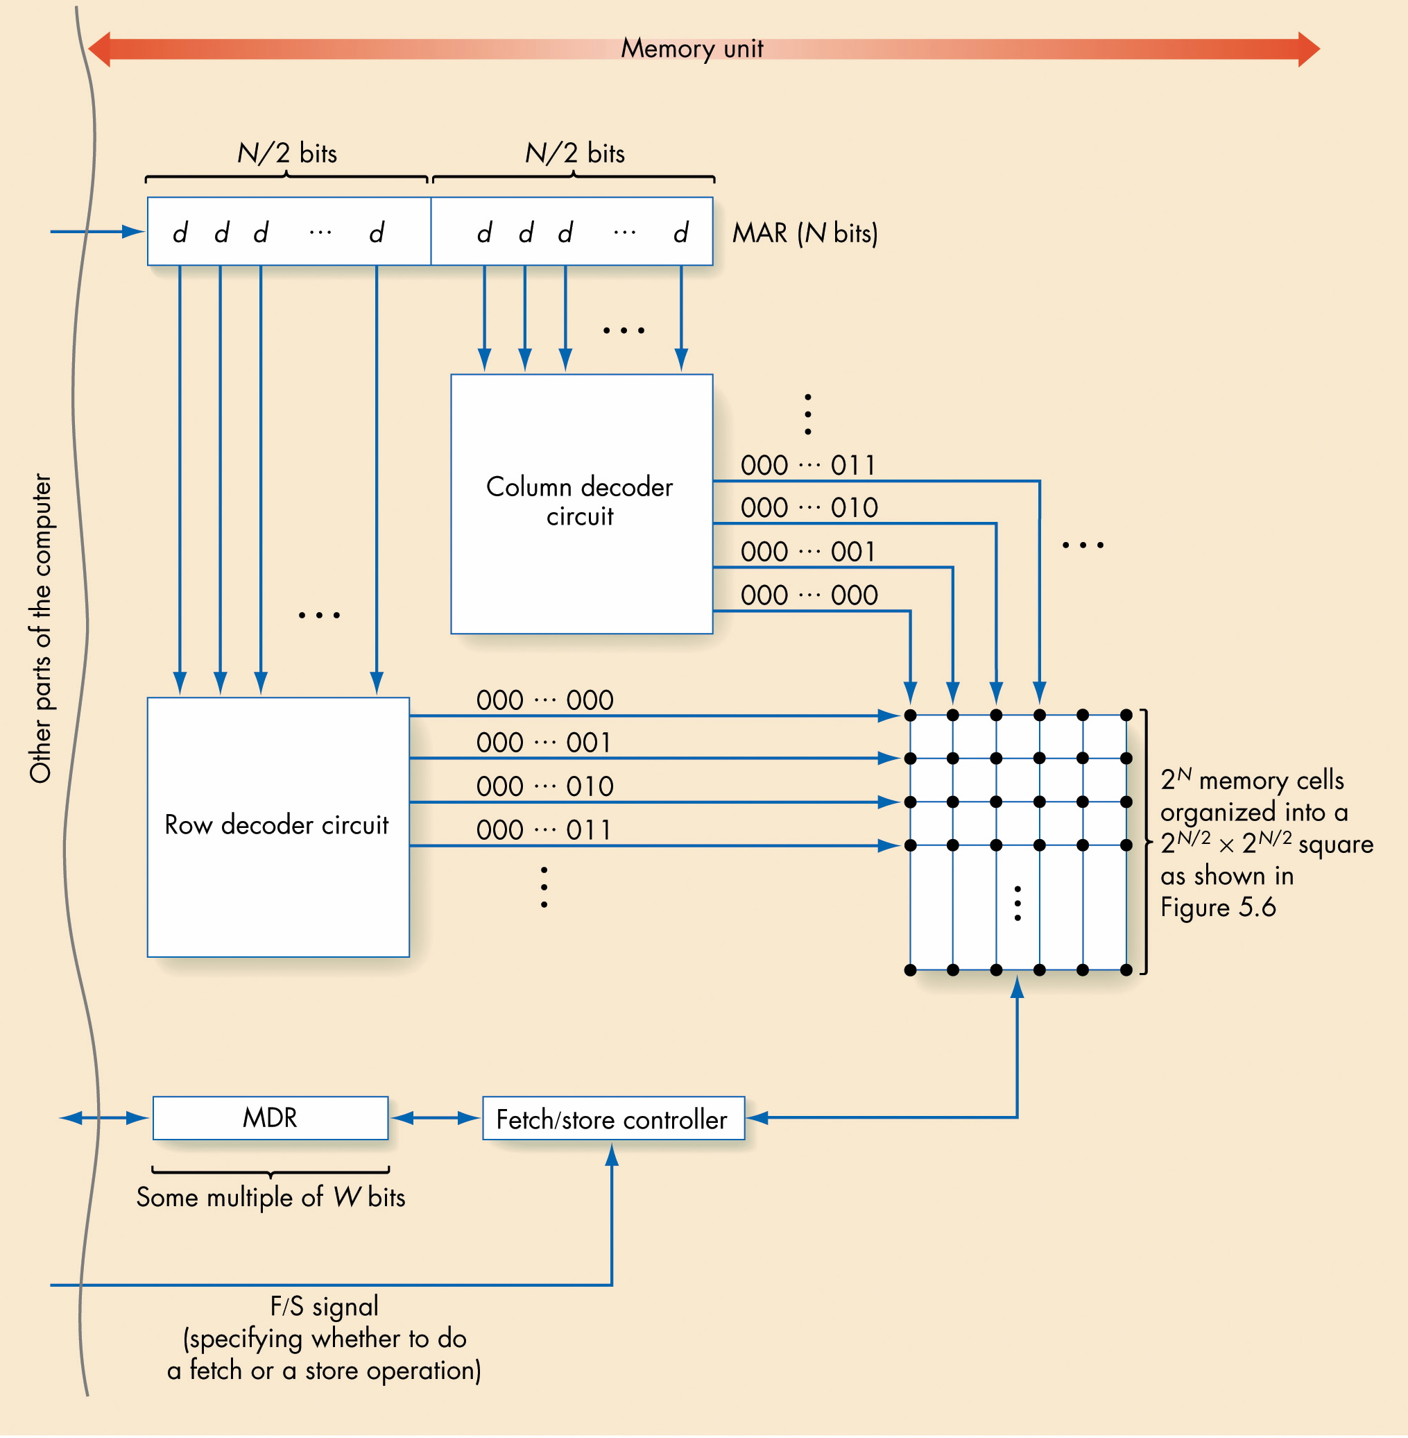
Overall RAM Organization

Slide 25
2D RAM Organization
MAR
0 1 1 1
Note that a 4 x 16 decoder was used for the 1-D memory.
2 x 4
decoder
columns
2 x 4
decoder
rows

Slide 26
Cache Memory
Memory access is much slower than processing time
Faster memory is too expensive to use for all memory cells
Locality principle
Once a value is used, it is likely to be used again
Small size, fast memory just for values currently in use speeds computing time

Slide 27
Input/Output and Mass Storage
Communication with outside world and external data storage
Human interfaces: Monitor, keyboard, mouse
Archival storage: Not dependent on constant power
External devices vary tremendously from each other

Slide 28
Input/Output and Mass Storage (continued)
Volatile storage
Information disappears when the power is turned off
Example: RAM
Nonvolatile storage
Information does not disappear when the power is turned off
Example: Mass storage devices such as disks

Slide 29
Input/Output and Mass Storage (continued)
Mass storage devices
Direct access storage device
Hard drive, CD-ROM, DVD, USB
Uses its own addressing scheme to access data
Sequential access storage device
Tape drive
Stores data sequentially

Slide 30
Input/Output and Mass Storage (continued)
Direct access storage devices
Data stored on a spinning disk
Disk divided into concentric rings (sectors)
Read/write head moves from one ring to another while disk spins
Access time depends on
Time to move head to correct sector (track): Seek time
Time for sector to spin to data location: Latency

Slide 31
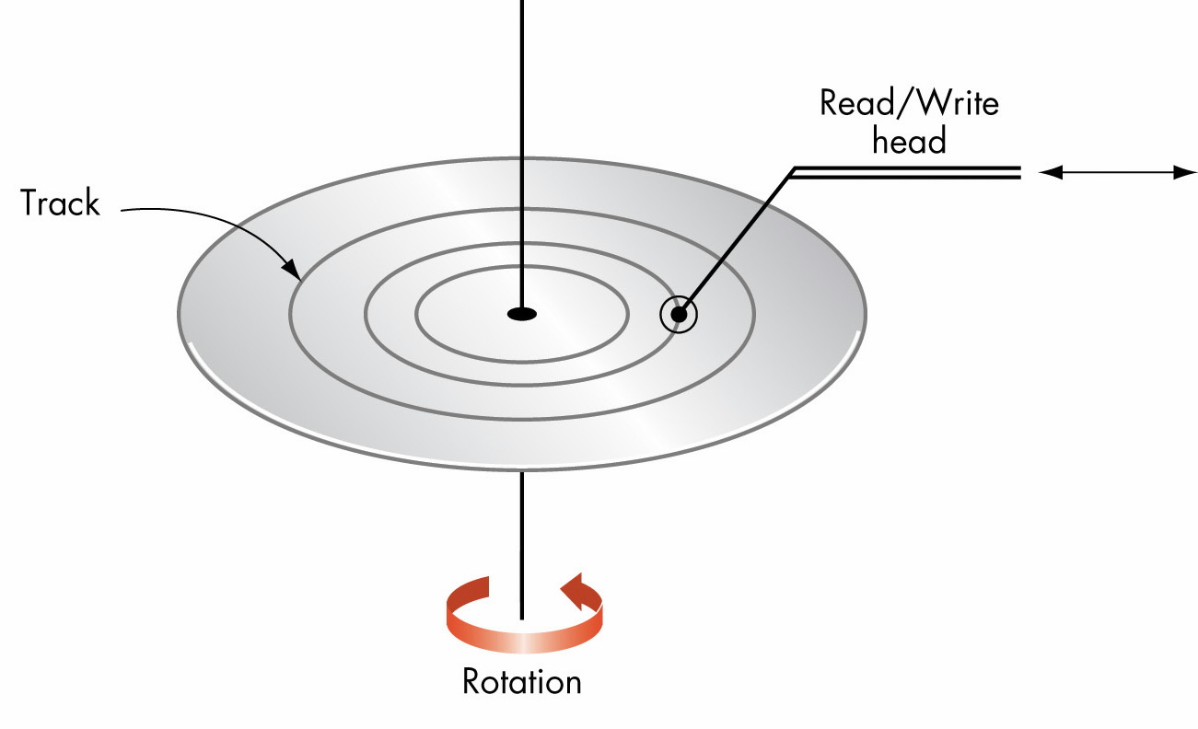
Overall Organization of a Typical Disk

Slide 32
Input/Output and Mass Storage (continued)
I/O controller
Intermediary between central processor and I/O devices
Processor sends request and data, then goes on with its work
I/O controller signals/interrupts processor when request is complete

Slide 33
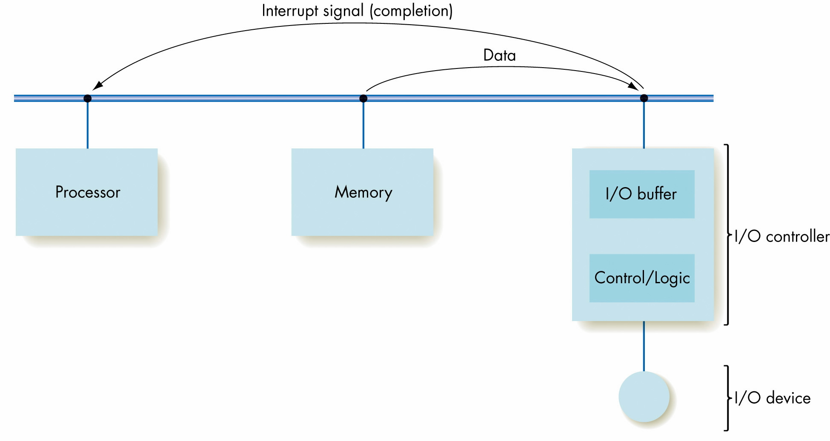
Organization of an I/O Controller

Slide 34
The Arithmetic/Logic Unit*
Arithmetic and Logic Unit
“Manufacturing” section of computer
Contains decision mechanisms and can make comparisons
Actual computations are performed
Primitive operation circuits
Arithmetic [+, -, *, /]
Comparison [equality or CE, GT, LT, NEQ]
Logic [AND, OR, NOT, XOR] Data inputs and results stored in registers
Multiplexor selects desired output

Slide 35
The Arithmetic/Logic Unit (continued)
ALU process
Values for operations copied into ALU’s input register locations
All circuits compute results for those inputs
Multiplexor selects the one desired result from all values
Result value copied to desired result register

Slide 36
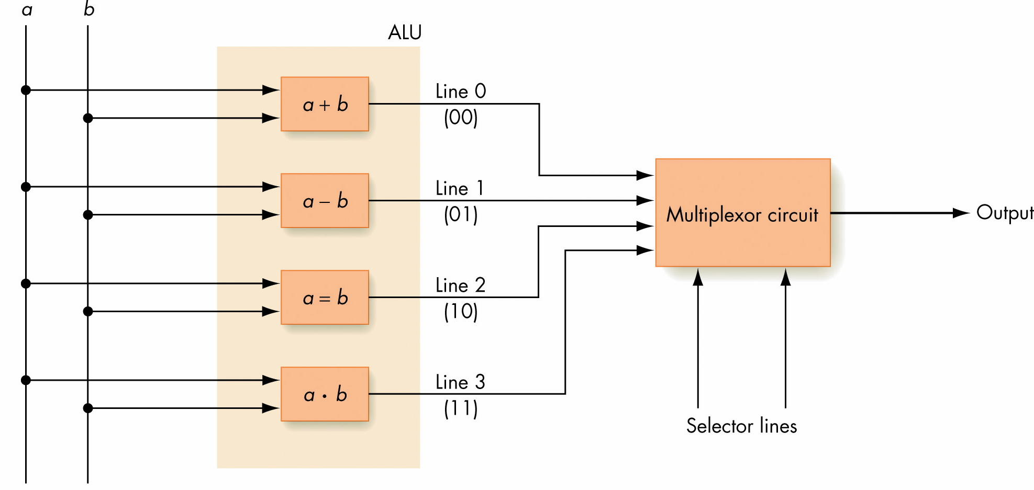
Using a Multiplexor Circuit to Select the Proper ALU Result

Slide 37
The Control Unit
Manages stored program execution
Task
Fetch from memory the next instruction to be executed
Decode it: Determine what is to be done
Execute it: Issue appropriate command to ALU, memory, and I/O controllers

Slide 38
Machine Language Instructions
Can be decoded and executed by control unit
Parts of instructions
Operation code (op code)
Unique unsigned-integer code assigned to each machine language operation
Address fields
Memory addresses of the values on which operation will work

Slide 39

Typical Machine Language Instruction Format

Slide 40
Machine Language Instructions
 | Instruction | Binary Op Code | Meaning
0 | Load | 0000
1 | Store | 0001
2 | Clear | 0010
3 | Add | 0011
4 | Increment | 0100
5 | Subtract | 0101
6 | Decrement | 0110
7 | Compare | 0111
8 | Jump | 1000
9 | Jump GT | 1001
10 | Jump EQ | 1010
11 | Jump LT | 1011
12 | Jump NEQ | 1100
13 | In | 1101
14 | Out | 1110
15 | Halt | 1111

Slide 41
Machine Language Instructions (continued)
Operations of machine language
Data transfer operations
Move values to and from memory and registers
Arithmetic/logic operations
Perform ALU operations that produce numeric values
Compare operations
Compare two values and set an indicator on the basis of the results of the compare; set register bits
Branch operations
Jump to a new memory address to continue processing

Slide 42
Control Unit Registers and Circuits
Parts of control unit
Links to other subsystems
Instruction decoder circuit
Two special registers
Program counter (PC)
Stores the memory address of the next instruction to be executed
Instruction register (IR)
Stores the code for the current instruction

Slide 43
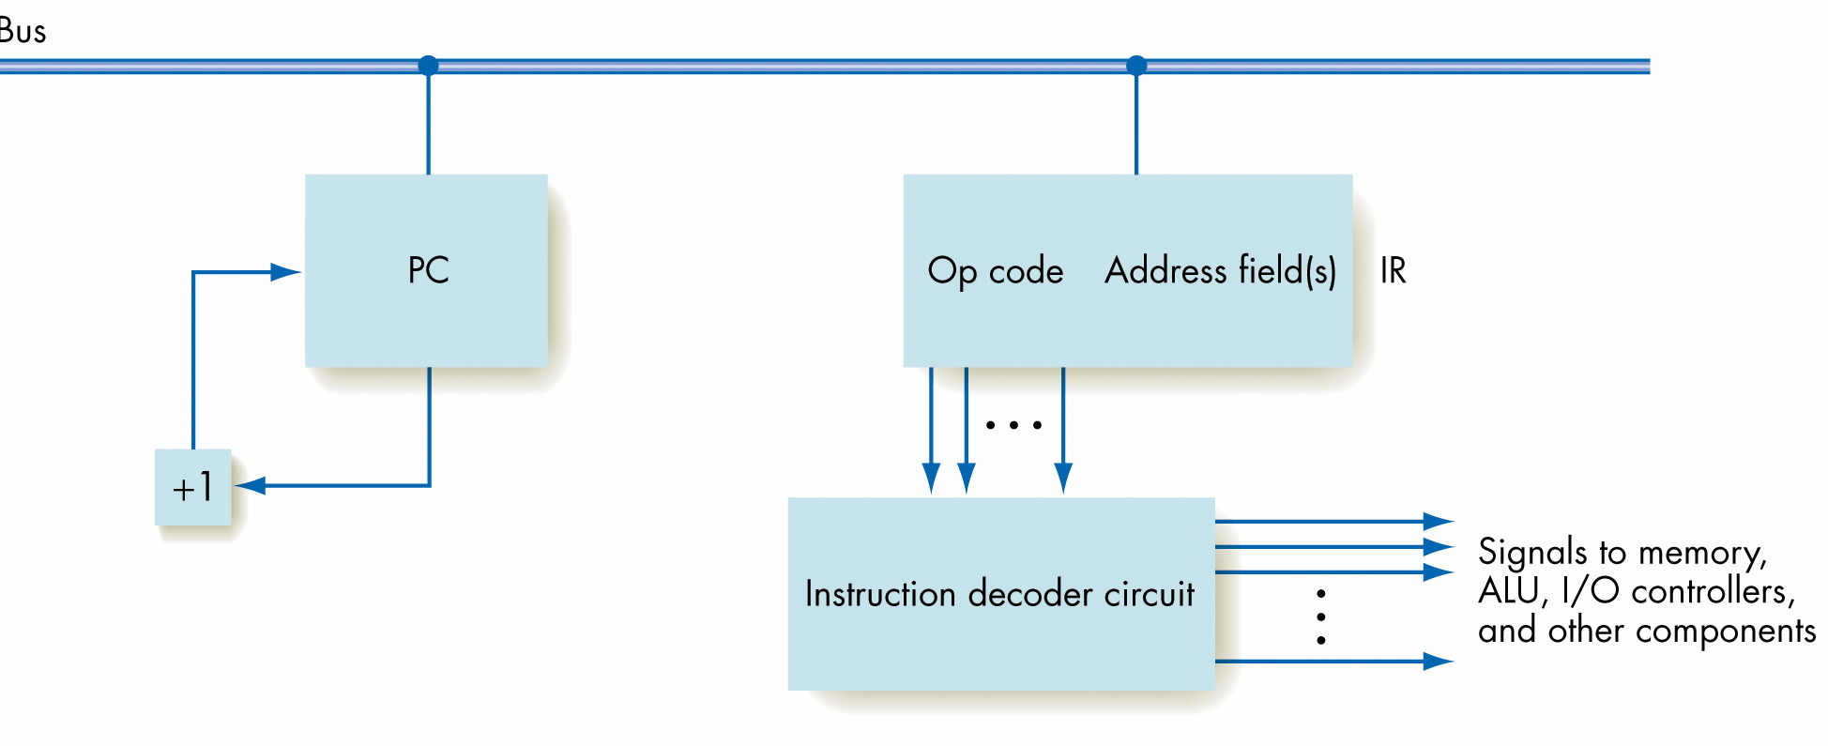
Organization of the Control Unit Registers and Circuits

Slide 44
Putting All the Pieces Together—the Von Neumann Architecture
Subsystems connected by a bus
Bus: Wires that permit data transfer among them
At this level, ignore the details of circuits that perform these tasks: Abstraction!
Computer repeats fetch-decode-execute cycle indefinitely

Slide 45
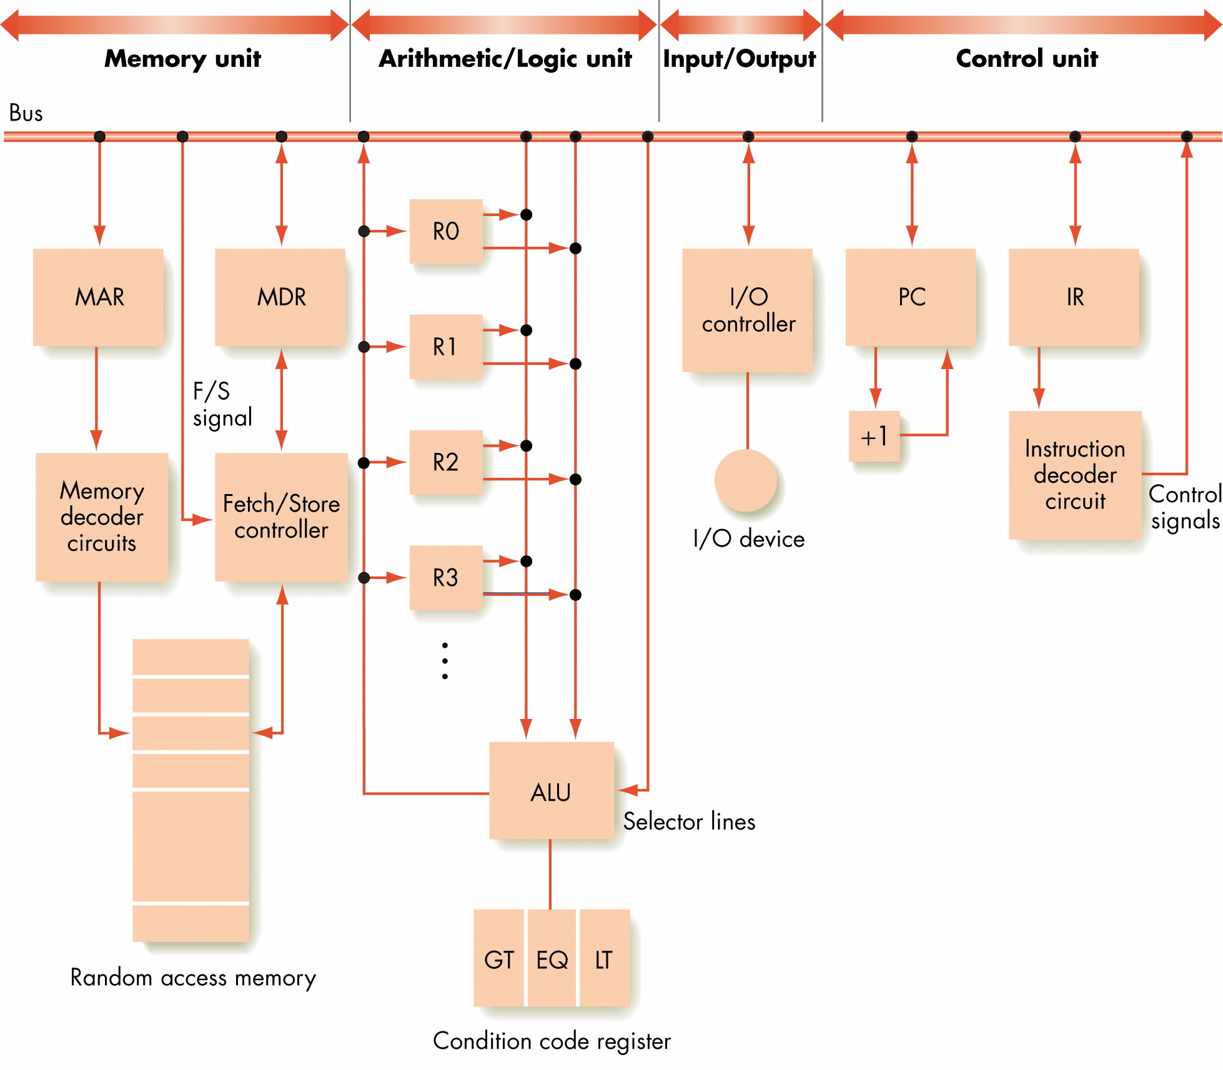

Slide 46
Non-Von Neumann Architectures
Physical limitations on speed of Von Neumann computers
Non-Von Neumann architectures explored to bypass these limitations
Parallel computing architectures can provide improvements; multiple operations occur at the same time

Slide 47
Non-Von Neumann Architectures
Parallel Architectures
Physical limitations on speed of Von Neumann computers
Non-Von Neumann architectures explored to bypass these limitations
Parallel computing architectures can provide improvements; multiple operations occur at the same time

Slide 48
SIMD Parallel Architectures
SIMD architecture
Single instruction/multiple data
Multiple processors running in parallel
All processors execute same operation at one time
Each processor operates on its own data
Suitable for vector operations

Slide 49
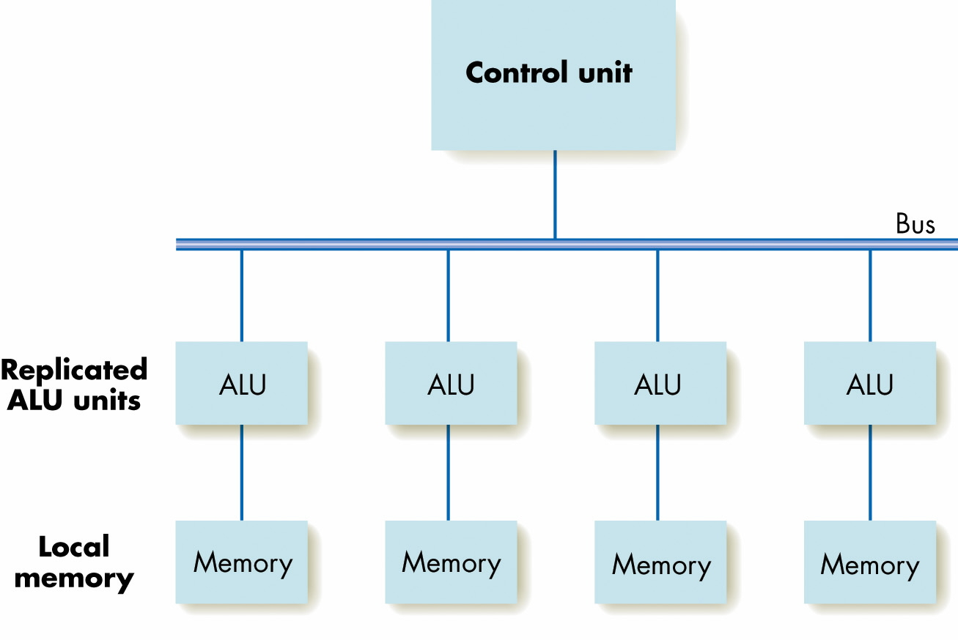
A SIMD Parallel Processing System

Slide 50
A SIMD Parallel Processing System

Slide 51
Associative SIMD
Associative Computer: A SIMD computer with certain additional hardware features.
Features can be supported (less efficiently) in software by a traditional SIMD
The name “associative” is due to its ability to locate items in the memory of PEs by content rather than location.
Uses associative features to simulate an associative memory
The ASC model (for ASsociative Computing) identifies the properties assumed for an associative computer

Slide 52
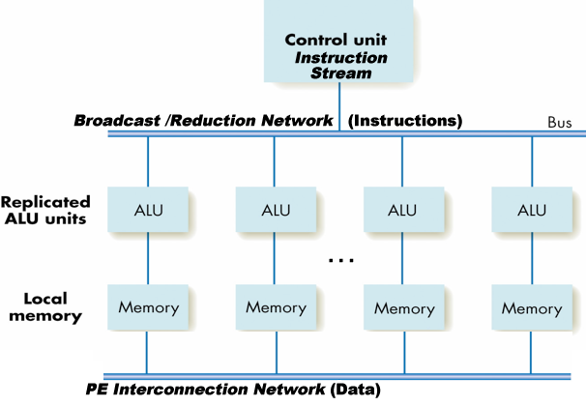
An ASC processor is a SIMD computer that has addi-tional hardware, in the form of a broadcast/reduction net-work, to support specific high-speed global operations.An ASC computer must be able to: broadcast from thecontrol unit to all PEs; search all PEs in parallel;
An Associative SIMD Parallel Processing System

Slide 53
MIMD Parallel Architectures
MIMD architecture
Multiple instruction/multiple data
Multiple processors running in parallel
Each processor performs its own operations on its own data
Processors communicate with each other

Slide 54
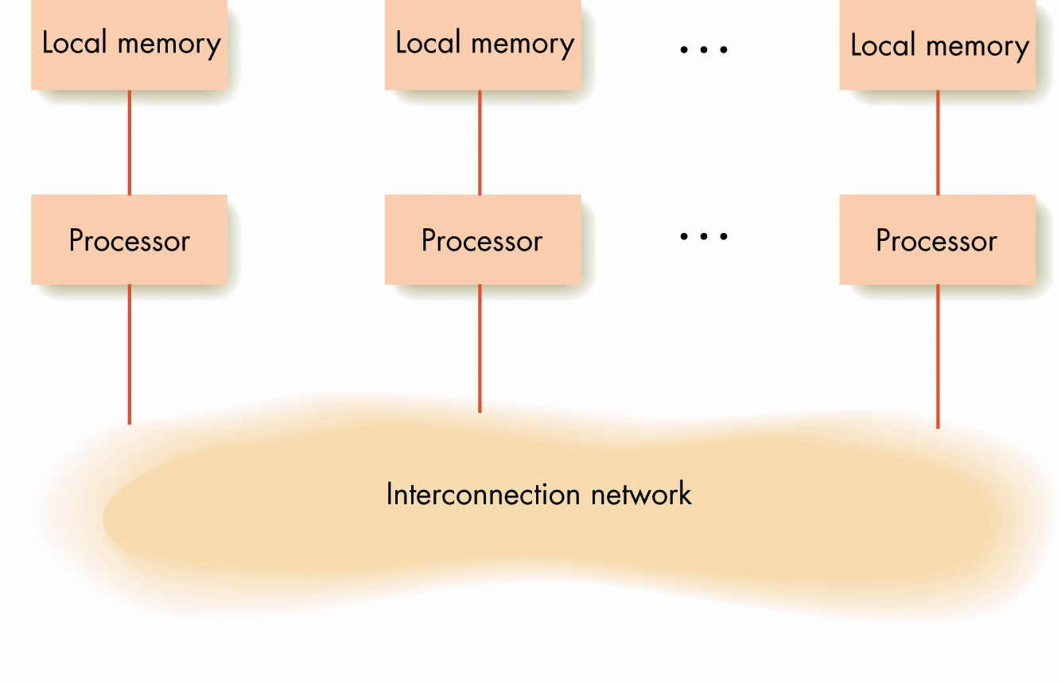
Model of MIMD Parallel Processing

Slide 55
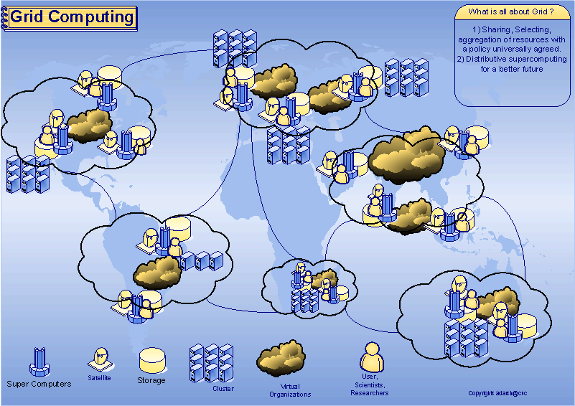
Grid Computing
Image source: http://www.adarshpatil.com/newsite/images/grid-computing.gif

Slide 56
More “flavors” of MIMD architectures - Cloud Computing
Cloud Computing - Internet or "cloud" based development and computing
Resources are provided as a service over the Internet.
Users need no knowledge of, expertise in, or control over the technology used (and usually won’t)
Amazon Elastic Compute Cloud (Amazon EC2)
Apple’s Mobile Me / Microsoft’s “Cloud OS” Azure

Slide 57
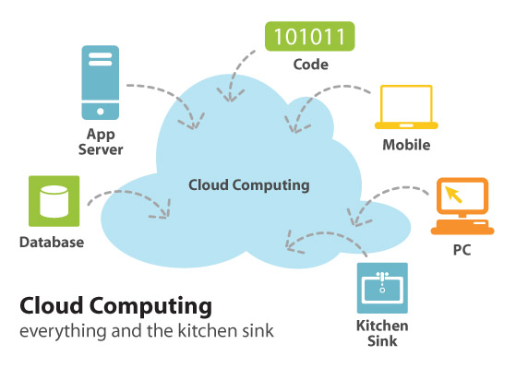
Cloud Computing…Sort of
Image Source: http://infreemation.net/cloud-computing-linear-utility-or-complex-ecosystem/

Slide 58
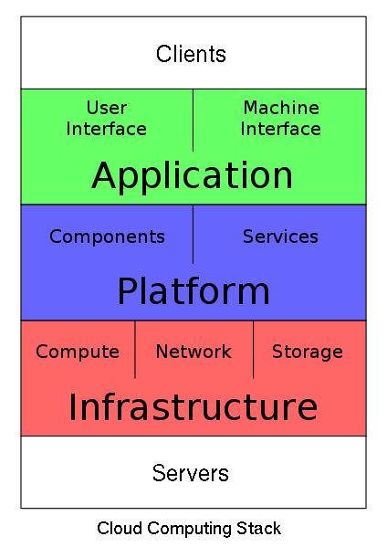
Cloud Computing
Service Model at a glance: Picture From http://en.wikipedia.org/wiki/File:Cloud_Computing_Stack.svg

Slide 59
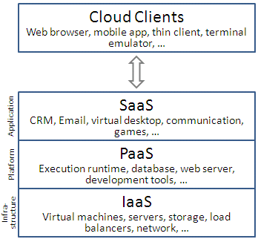
Cloud Computing

Slide 60
Types of Cloud Computing
Private Cloud:
The cloud is operated solely for an organization. It may be managed by the organization or a third party and may exist on premise or off premise.
Community Cloud:
The cloud infrastructure is shared by several organizations and supports a specific community that has shared concerns.
It may be managed by the organizations or a third party and may exist on premise or off premise
Public Cloud:
The cloud infrastructure is made available to the general public or a large industry group and it is owned by an organization selling cloud services.
Hybrid cloud:
The cloud infrastructure is a composition of two or more clouds (private, community, or public).

Slide 61
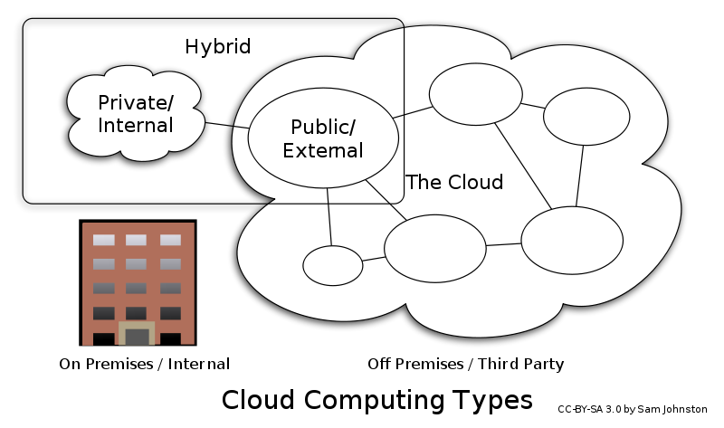
Types of Cloud Computing

Slide 62
Advantages of Cloud Computing
Cloud computing do not need high quality equipment for user, and it is very easy to use.
Provides secure data storage center.
Reduce run time and response time.
Cloud is a large resource pool that you can buy on-demand service.
Scale of cloud can extend dynamically providing nearly infinite possibility for users to use internet.

Slide 63
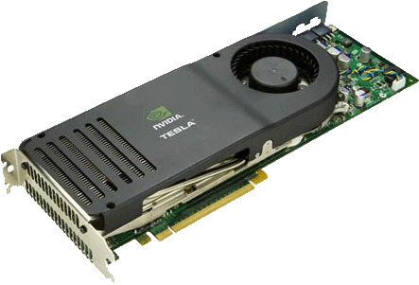
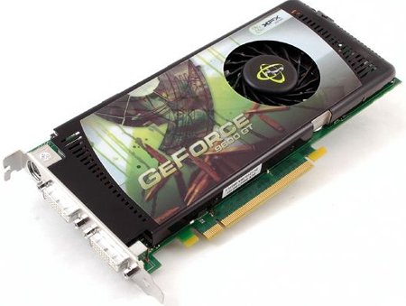
General-purpose Programming on Graphics Processors (GPGPU)
Hybrid MIMD and SIMD computing
Uses the computation power of graphics card for non-graphics applications
NVIDIA C870 Tesla GPGPU
518 Peak GFLOPS on Tesla
170W peak, 120W typical
NVIDIA GeForce 9600GT

Slide 64
Summary
Computer organization examines different subsystems of a computer: memory, input/output, arithmetic/logic unit, and control unit
Machine language gives codes for each primitive instruction the computer can perform and its arguments
Von Neumann machine: Sequential execution of a stored program
Parallel computers improve speed by doing multiple tasks at one time

